Slide 1
R programming

Slide 2
What is R?
R is a programming language developed by Ross Ihaka and Robert Gentleman in 1993. R possesses an extensive catalog of statistical and graphical methods. It includes machine learning algorithm, linear regression, time series, statistical inference to name a few. Most of the R libraries are written in R, but for heavy computational task, C, C++ and Fortran codes are preferred.
R is not only entrusted by academic, but many large companies also use R programming language, including Uber, Google, Airbnb, Facebook and so on.

Slide 3
Cont...
Data analysis with R is done in a series of steps; programming, transforming, discovering, modelling and communicate the results
Program: R is a clear and accessible programming tool
Transform: R is made up of a collection of libraries designed specifically for data science
Discover: Investigate the data, refine your hypothesis and analyze them
Model: R provides a wide array of tools to capture the right model for your data
Communicate: Integrate codes, graphs, and outputs to a report with R Markdown or build Shiny apps to share with the world

Slide 4
What is R used for?
Statistical inference
Data analysis
Machine learning algorithm
The theory, methods, and practice of forming judgements about the parameters of a population and the reliability of statistical relationships, typically on the basis of random sampling.

Slide 5
R by Industry
If user break down the use of R by industry, user see that academics come first. R is a language to do statistic. R is the first choice in the healthcare industry, followed by government and consulting.

Slide 6
R package
The primary uses of R is and will always be, statistic, visualization, and machine learning.

Slide 7
Why use R?
Data science is shaping the way companies run their businesses. Without a doubt, staying away from Artificial Intelligence and Machine will lead the company to fail.
They are plenty of tools available in the market to perform data analysis. Learning a new language requires some time investment. The picture below depicts the learning curve

Slide 8
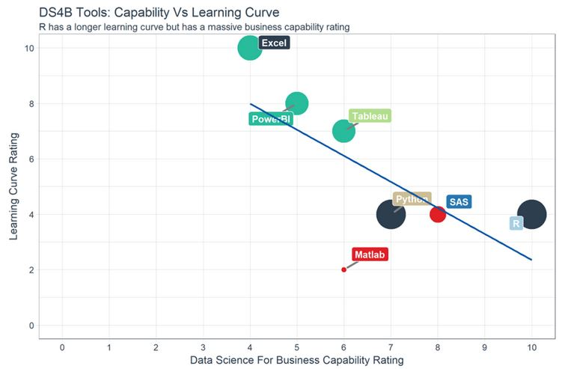

Slide 9
Summary
In a nutshell, R is a great tool to explore and investigate the data. Elaborate analysis like clustering, correlation, and data reduction are done with R. This is the most crucial part, without a good feature engineering and model, the deployment of the machine learning will not give meaningful results.

